Slide 1


SurveillanceSim Project
“Improving disaster preparedness and response through improved training and decision making”
Dr Chris Skelly
Institute for the Environment
Brunel University
chris.skelly@brunel.ac.uk

Slide 2
SurveillanceSim Project
Aug 2006
Disease Transmission
Model
Commercial Sale
R&D

Slide 3
SurveillanceSim Project
Feb 2007
Disease Transmission
Modelling Environment
Person-Person
Model
R&D
Disease Transmission
Model
Disease Transmission
Model

Slide 4
SurveillanceSim Project
Aug 2007
ieSim ADE
Application Development Environment
OutbreakP2P
Model
R&D
Disease Transmission
Model
Disease Transmission
Model

Slide 5
The Products
Application Development Environment
provides the tools to allow others to build simulation applications
ieSim ADE
ieSim AE
outbreakP2P
Sept
Application Environment
allows others to run applications
Nov
Application
allows others to simulate a person-person disease outbreak

Slide 6
Market Segmentation
ieSim ADE
Emergency management
Disaster preparedness
Facilities management
All levels of government
Education & training
outbreakP2P
Public health professionals
Education
Any organisation required to prepare a pandemic plan
WIDE & SHALLOW
NARROW & DEEP

Slide 7
Product Usage
ieSim ADE
Using the libraries and software tools we’ve developed we facilitate other parties building their own simulation models
Anyone who develops simulation models in this environment will have experience of C++ and software development, therefore although this will have wide appeal there will be relatively few groups with this expertise
Big organisations, software development specialists, research & development teams

Slide 8
Product Usage
ieSim AE
This is the ‘run time’ environment which all simulation models need to be ‘plugged into’ in order to run simulations
This is the equivalent of the ‘Adobe PDF Reader’ in the simulation world – where you pay to create but not to read
Everyone who uses an ieSim based model

Slide 9
Product Usage
outbreakP2P
Our first application developed for the ieSim AE
It provides a space time simulation tool for disease outbreaks
A very large audience within the public health profession and beyond in the case where large organisations prepare pandemic plans

Slide 10
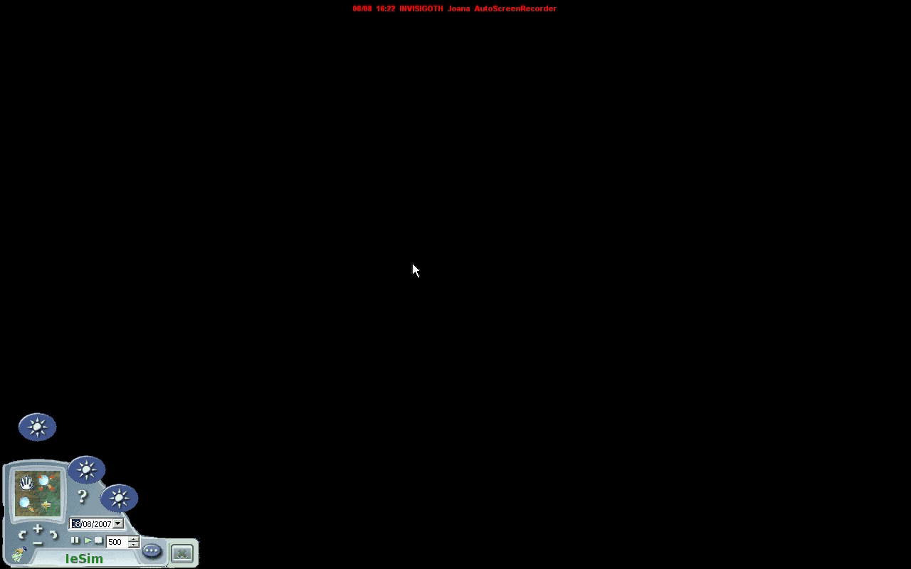
outbreakP2P
The user builds a ‘simulation’ community using two very common sources of real-world data.

Slide 11

outbreakP2P
The user parameterises the disease hazard.

Slide 12
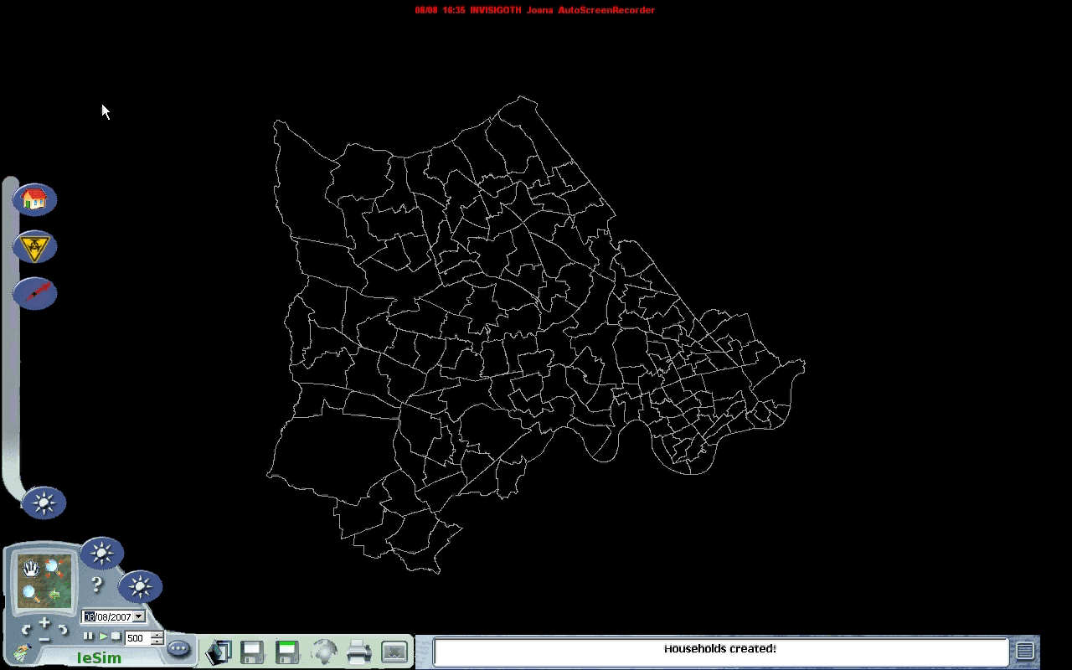
outbreakP2P
The user parameterises the disease interventions.

Slide 13
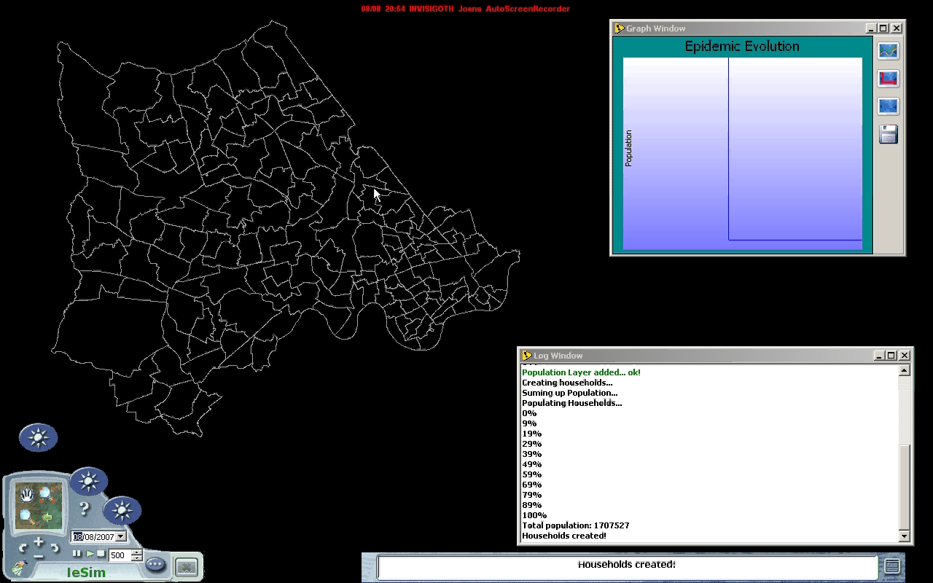
outbreakP2P
The user runs disease transmission & intervention scenarios

Slide 14
Summary outbreakP2P product
The user buys and downloads an application, example outbreakP2P
The user downloads the ieSim AE
The user installs both and runs ieSim AE, which then finds the application and starts it within it’s simulation environment

Slide 15
Product Placement
Simulation Systems, e.g. Simula, Simul8
Programming From Scratch
Transmission Model
BESPOKE
Can only change parameters
ieSim ADE
+ spatial
+ focussed on communities
+ hazard events & interventions
+ multi-platform

Slide 16
“Improving disaster preparedness and response through improved training and decision making”
Thank you!

